Slide 1
DR.SNSRCAS, CBE
SUBJECT: ADVANCED JAVA PROGRAMMING
COURSE CODE:16UCA502
TITLE: Strut framework in JAVA
YEAR: V SEMESTER 2022-2023 (ODD)

Slide 2
Strut framework in JAVA.
Struts is an open source framework that extends the Java Servlet API and employs a Model, View, Controller (MVC) architecture. It enables you to create maintainable, extensible, and flexible web applications based on standard technologies, such as JSP pages, JavaBeans, resource bundles, and XML.

Slide 3
Strut framework in JAVA.
Struts is used to create a web applications based on servlet and JSP. Struts depend on the MVC (Model View Controller) framework. Struts application is a genuine web application. Struts are thoroughly useful in building J2EE (Java 2 Platform, Enterprise Edition) applications because struts takes advantage of J2EE design patterns. Struts follows these J2EE design patterns including MVC.

Slide 4
Strut framework in JAVA.
In struts, the composite view manages the layout of its sub-views and can implement a template, making persistent look and feel easier to achieve and customize across the entire application. A composite view is made up by using other reusable sub views such that a small change happens in a sub-view is automatically updated in every composite view.

Slide 5
Strut framework in JAVA.
Struts consists of a set of own custom tag libraries. Struts are based on MVC framework which is pattern oriented and includes JSP custom tag libraries. Struts also supports utility classes.

Slide 6
Strut framework in JAVA.
Features of Struts: Struts has the following features:
1. Struts encourages good design practices and modeling because the framework is designed with “time-proven” design patterns.
Struts is almost simple, so easy to learn and use.

Slide 7
Strut framework in JAVA.
Features of Struts: Struts has the following features:
It supports many convenient features such as input validation and internationalization.
It takes much of the complexity out as instead of building your own MVC framework, you can use struts.

Slide 8
Strut framework in JAVA.
Features of Struts: Struts has the following features:
Struts is very well integrated with J2EE.
Struts has large user community.
It is flexible and extensible, it is easy for the existing web applications to adapt the struts framework.

Slide 9
Strut framework in JAVA.
Features of Struts: Struts has the following features:
Struts provide good tag libraries.
It allows capturing input form data into javabean objects called Action forms.
It also hand over standard error handling both programmatically and declaratively.

Slide 10
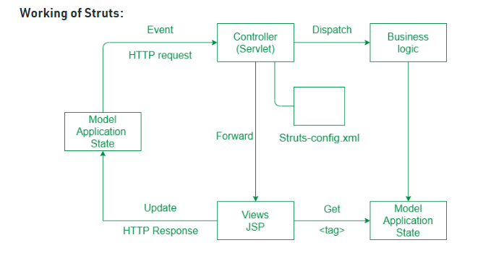
Strut framework in JAVA.

Slide 11
THANK YOU

